Slide 1
API4KP API for Knowledge Bases and Knowledge Platforms
ad/2017-11-08 Initial Submission ad/2017-11-08 Response to RFP ad/2010-06-09
Davide Sottara, PhD Department of Biomedical Informatics, Arizona State University Mayo Clinic

Slide 2
Background
Large Scale Knowledge-Driven applications require complex, heterogeneous Knowledge Bases
OWL Ontologies
UML (Class) Models
BPMN / DMN / CMMN Process Models
PMML Predictive Models
RuleML / RIF / SWRL / CL Rules
…
APIs, when exist, are proprietary and/or strongly coupled
to Languages (e.g. OWL-APIs)
to Engines/Reasoners (e.g. any commercial BxMS)

Slide 3
Background
Original RFP addressed (OWL) ontology KBs only
(older versions of) OWL-API and Jena the only options
“micro-API”
Decouple representation from reasoning
Response generalizes the proposal
Add management and delivery dimensions
Supports other kinds of representable knowledge, and languages for the expression thereof
Supports the notion of Composite (heterogeneous) KBs

Slide 4
Initial Submission Group
Various Contributors from multiple Organizations over time
Submitters
88 Solutions
Adaptive, Inc.
Model Driven Solutions
Thematix Partners LLC
Supporters
Arizona State University
Athan Services
Cognitive Medical Systems
Mayo Clinic
U.S. Department of Commerce
Otto von Guericke University of Magdeburg
Raytheon Company

Slide 5
Initial Submission Group
Mix of contributor with different backgrounds
Academic
Industrial
Independent Consulting
Cross-industry standard
with focus on healthcare

Slide 6
Submission Scope
APIs for Knowledge Platforms, to be used in the development of Knowledge-based Applications
Semantics of the Operations exposed by means of the APIs
Decomposition of the Operations into simpler Actions
Definition of ‘Knowledge Base’, ‘Knowledge Resource’ and related concepts
Definition of ‘Knowledge Platform’ in terms of the functional roles of its major components
Information Models realizing Descriptions (‘metadata’) of Knowledge Resources minimally viable for Knowledge Management and Delivery
including Vocabularies to designate Knowledge Representation Languages/Notations and related concepts

Slide 7
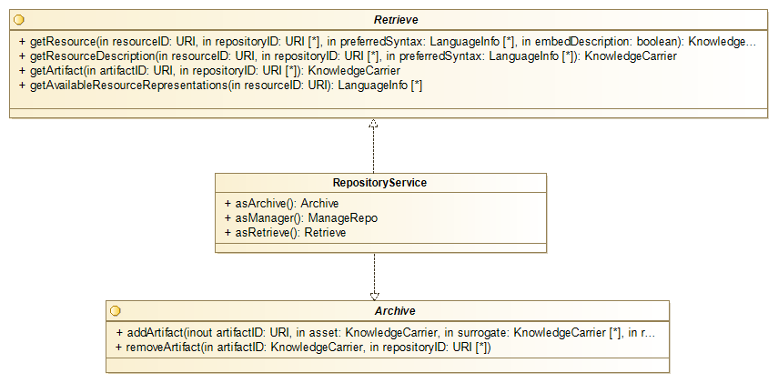
Repository Module

Slide 8
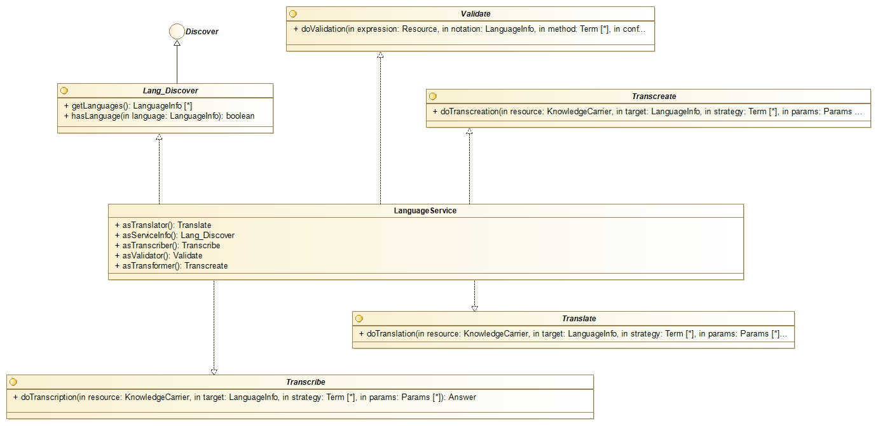
Language Module

Slide 9
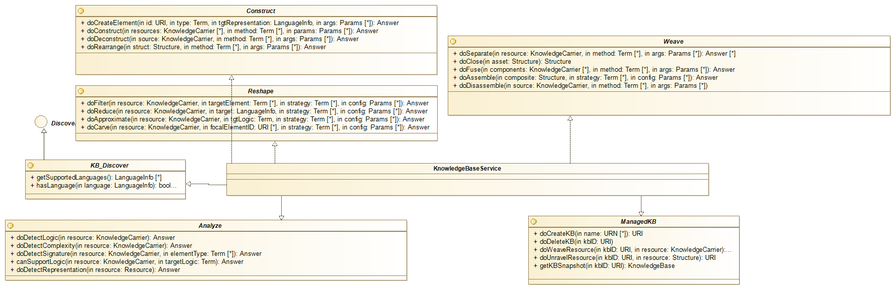
Knowledge Base Module

Slide 10
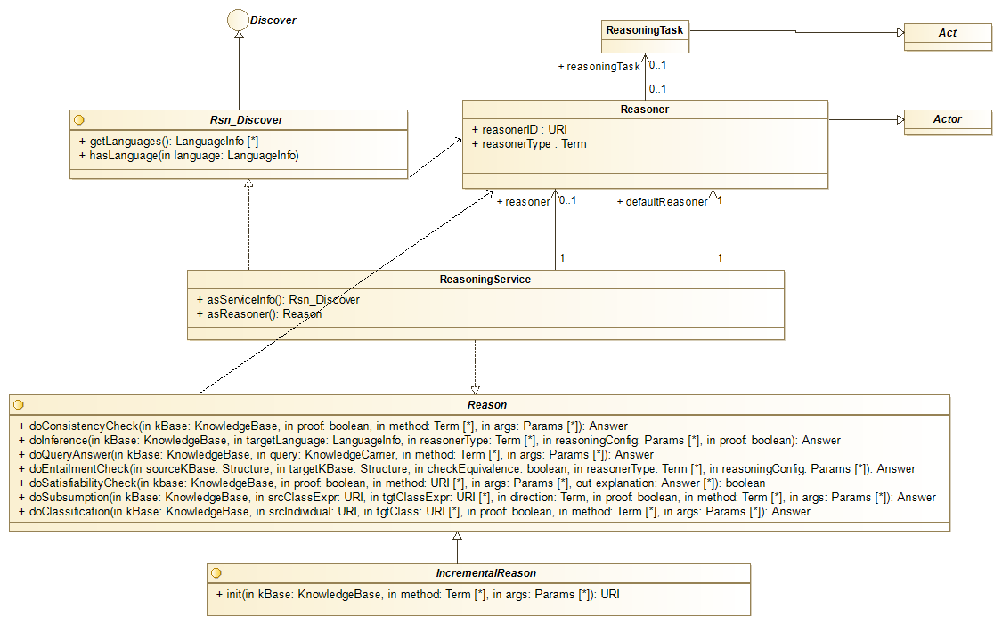
Reasoning Base Module

Slide 11
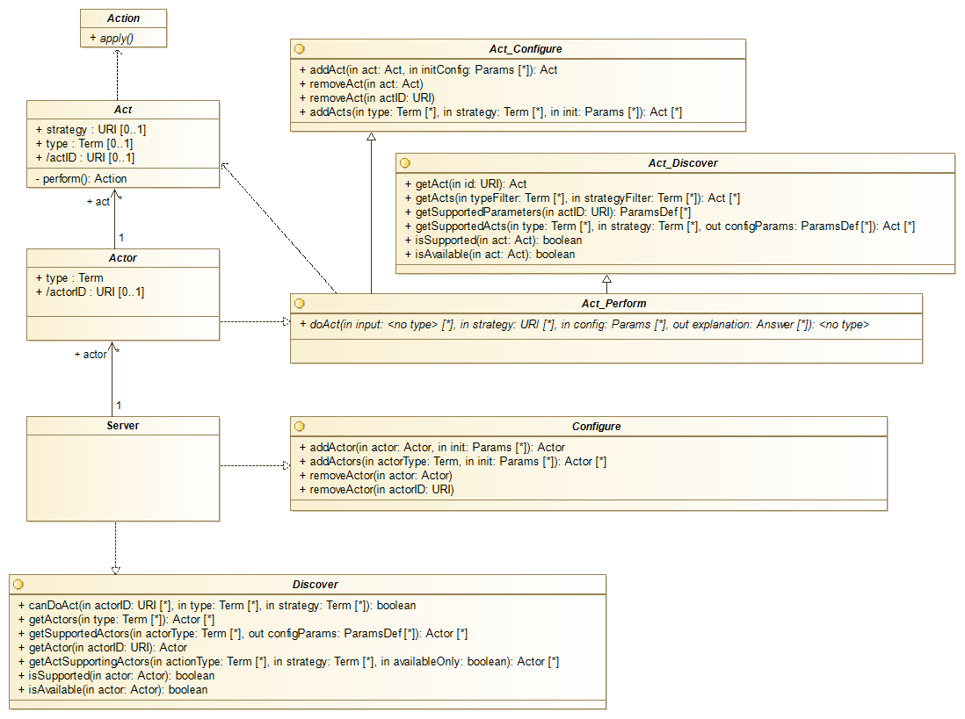
Platform Module

Slide 12
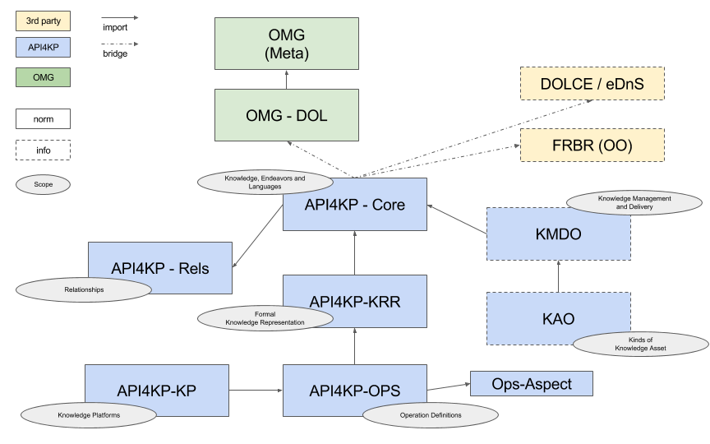
Ontologies

Slide 13
Requirements
Requirements – Reference Model | Status
PIM model expressed in UML / MOF | Supported
UML Model – Platform Architecture | Draft
IDL Model – Operations specification | Not Started
OWL Model – Underlying Ontology | Initial Version
Most Supported features are nevertheless incomplete and subject to evolution

Slide 14
Requirements
Requirements – KB Interrogation | Status
List Ontologies in a KB (→ Extract “Resources”) | Supported
List Entities: Classes, Relationships, Datatypes and Individuals in a KB (→ Carve “Resource Fragments”) | Supported
List Entities logically related to an Entity: Sub-, Super-, Equivalent (→ Carve “Resource Fragments”) | Supported
Resolve URIs of Entities to Representations thereof, and vice-versa (→ Query / Carve “Resouce Fragments” ) | Supported
Test the (structural) Equivalence of two Entities given their representation (→ Parse + Diff “Expressions” ) | Supported
Most Supported features are nevertheless incomplete and subject to evolution

Slide 15
Requirements
Requirements – Knowledge Resource Modification | Status
Construct an Entity (Class, Rel., Individual, ...) in an Ontology (→ Construct “Resource (Fragment)” + Merge) | Supported
Delete an Entity (Class, Rel., Individual, ...) in an Ontology (→ Filter “Resource (Fragment)”) | Supported
Modification of an Entity (Class, Rel., Individual, ...) in an Ontology (Construct + Filter with Versioning) | Supported
Most Supported features are nevertheless incomplete and subject to evolution

Slide 16
Requirements
Requirements – KP Inference | Status
Check the Consistency of a KB (→ Check Consistency ) | Supported
Check the Satisfiability of a KB (→ Check Satisfiability ) | Supported
Test the (mutual) entailment / equivalence between two KBs (→ Check Entailment ) | Supported
Test the (mutual) subsumption between two Expressions Retrieve all the subsuming/ed Entities given an Expression (→ Check Subsumption ) | Supported
Test for Class membership of an Individual Retrieve all the Classes an Individual is member of Retrieve all members of a Class (→ Check Memberhsip ) | Supported
Answer (conjunctive) Queries (→ Query ) | Supported
Most Supported features are nevertheless incomplete and subject to evolution

Slide 17
Requirements
Requirements – KB Manipulation | Status
Load an OWL Ontology or a RDF Graph in a KB) (→ Add Resource to KB ) | Supported
Unload Ontology from KB (→ Remove Resource from KB ) | Supported
Export and Serialized Ontology (→ All “Syntactic” Operations ) | Supported
Most Supported features are nevertheless incomplete and subject to evolution

Slide 18
Requirements
Requirements – PSM | Status
Bind PIM to JAVA | In Progress
Bind PIM to WSDL | Not Started
Bind PIM to REST | In Progress
Support PSM Serializations / Implementations | In Progress
Most Supported features are nevertheless incomplete and subject to evolution

Slide 19
Discussion
Exception / Explanation Handling
Most Operations return an (optional) Explanation secondary output
An Explanation is a Knowledge Resource itself, expressed in some KRR language
Usually provided natively by KP Components
Explanations are structured into complex Resources as Operations are chained
This capability is expected to be provided by the API layer
Provenance concepts can be leveraged by actual implementations (e.g. W3C Prov)

Slide 20
Discussion
Performance Impact
API overhead should be minimal
APIs expose, rationalizing and normalizing them, functionalities normally required to use knowledge bases and related platforms
APIs are compatible with implementations based on facades
API granularity may change to minimize the number of invocations required by common use cases, across use cases
Pilot implementation @Mayo Clinic
Web-Service oriented PSMs may be critical
(same as above)
APIs designed for chaining
Resources can be passed by Reference
Most operations are functional (→ caching) and suitable for lazy implementations

Slide 21
Discussion
Security
API specification is transparent to any security layer imposed around (i) access to Knowledge Resources and (ii) invocation of the APIs.
E.g. RESTful implementations are likely to use OAuth or other state of the art mechanisms
Caveats
Knowledge Resource Descriptions (aka “metadata”) carry licensing information, possibly expressed in a computable format
APIs can be used to abstract knowledge-based policy enforcement systems, or components thereof (e.g. access control rules implemented in a BRMS)

Slide 22
Discussion
Related Works
CTS-2
A terminology service is a special case of KP, working on KBs of a specific kind
A conceptual mapping of CTS-2 like* operations to particular configurations of API4KP operations will be provided as a corollary
DOL
API4KP is more general than DOL
DOL makes more specific assumptions about the nature of Knowledge Resources and Knowledge Bases.
API4KP reuses, generalizing them, many of the concepts and operations defined in DOL
DOL can provide API4KP services
DOL specifications describe complex KB, and are Knowledge Resources themselves
DOL specifications could be interpreted in terms of (chains of) API4KP operations
Implementations of DOL operations could be exposed through API4KP

Slide 23
Discussion
Changes to ODM
No need to change the ODM has arisen
Standard URIs to denote logics, languages and formats for knowledge representation – and versions thereof - are needed
The role of ‘model’ MIME types is being investigated

Slide 24
Next Steps
Refine the documentation of the specification
Produce the machine-computable files
Refine the PIM model
Create the PSM model
Consolidate the implementation
Demonstrate utility
Reference implementation at Mayo Clinic
Implement wrappers around service providers (e.g. open source knowledge repositories, reasoners/engines, etc..)
Demonstrate usability
Improve development cycles
Convenient orchestration

Slide 25
Important Dates
Status update
Q1 2018
Revised submission
Q2 2018

